Slide 1
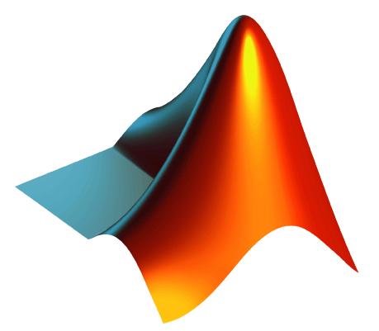
MATLAB

Slide 2



ABOUT ME
Third year engineering student from Universiti Teknologi PETRONAS (UTP).
Major in Electrical & Electronics Engineering.
Minor in Big Data Analytics.
Performed various tasks using MATLAB in different fields like signal processing, artificial intelligence, face recognition, etc.
tanlitung.github.io
linkedin.com/in/tanlitung

Slide 3
PROJECTS
Engineering Team Project
Integrated Project
Fast Prototyping
Final Year Project
Simulations

Slide 4
HOW?
MATLAB

Slide 5
GOAL FOR TODAY
Learn the basics of MATLAB
(You might use this in your assignments)

Slide 6
OVERVIEW
Introduction to MATLAB
Applications of MATLAB
Hands-on MATLAB Activities
Questions and Answer

Slide 7
WHAT IS MATLAB?
MATLAB® (Matrix Laboratory) is a programming platform designed specifically for engineers and scientists.
Written in Fortran in the late 1970s by Cleve Moler, it was a simple interactive matrix calculator.
In 1983, Jack Little, who was an engineer, visited Moler for MATLAB. He sees the commercial potential in MATLAB, so Jack Little joined hands with Steve Bangert and Moler to rewrite MATLAB in C Language.
This was also accompanied with the formation of MathWorks in the year 1984 to further enhance the development of MATLAB.

Slide 8


HISTORY OF MATLAB
1970s
Cleve Moler

Slide 9




HISTORY OF MATLAB
1983 - 1984
Cleve Moler
Jack Little
Steve Bangert

Slide 10
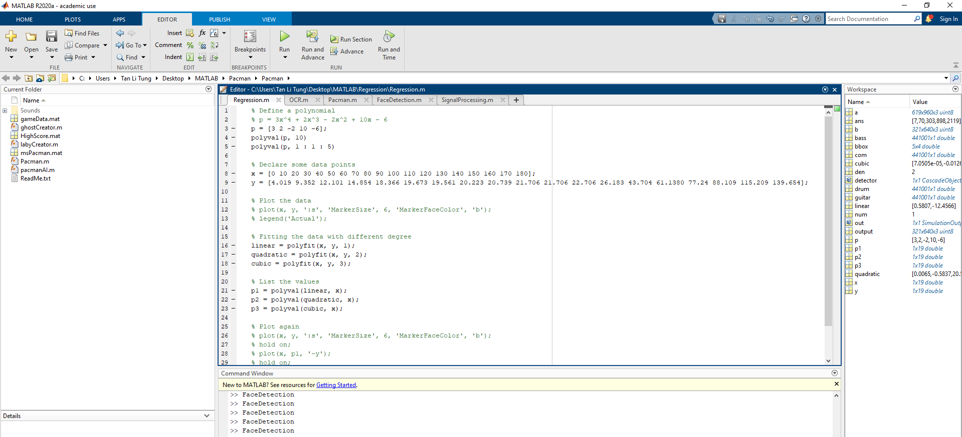
WHY USE MATLAB?
Easy and intuitive.

Slide 11

WHY USE MATLAB?
Designed for Engineers and Scientist.

Slide 12
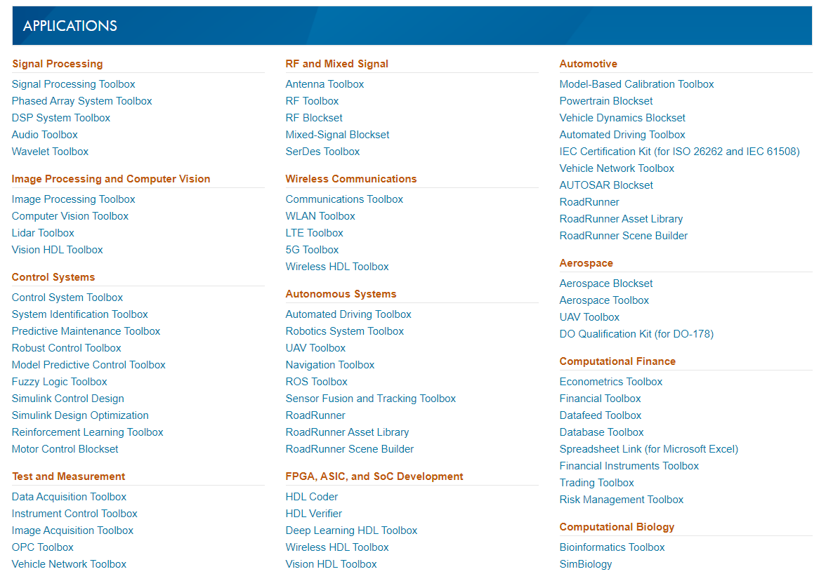
WHY USE MATLAB?
Lots of Toolboxes available (Lots of resources).
More at:
https://www.mathworks.com/products/index.html?s_tid=hp_fp_viewall

Slide 13
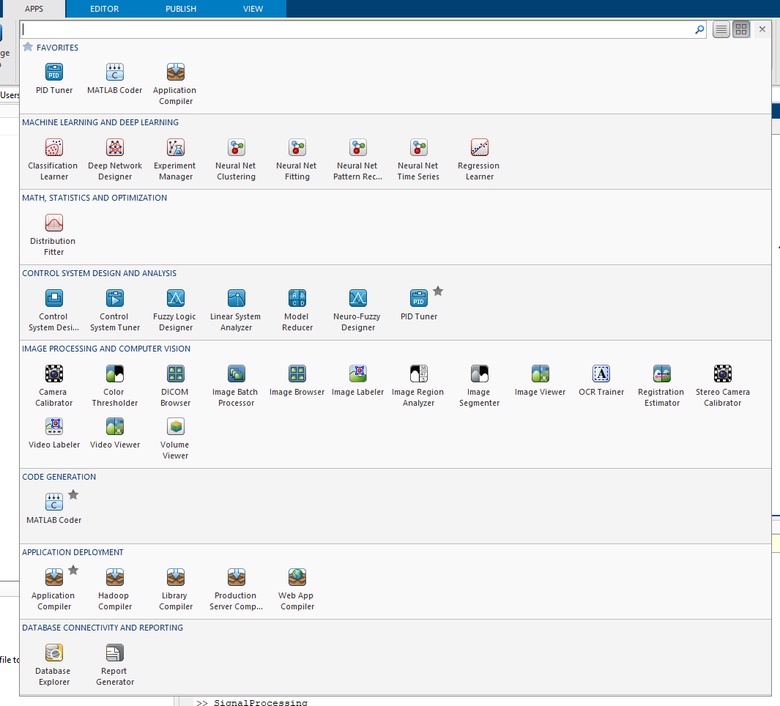
WHY USE MATLAB?
MATLAB App (No need to code!).

Slide 14
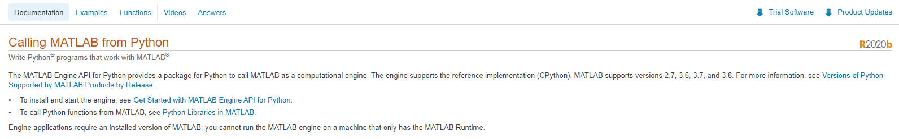
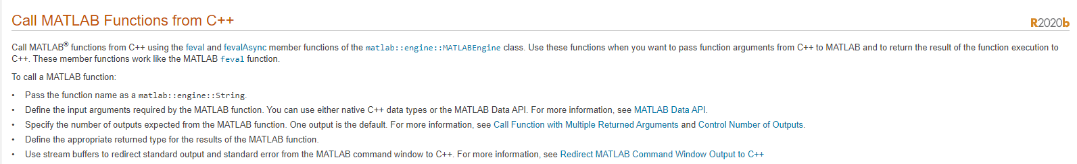
WHY USE MATLAB?
MATLAB integrates workflow. Fast. Reliable.

Slide 15
APPLICATIONS
Matrix calculations.
Plots of graphs.
Machine learning.
Signal processing.
Face recognition.
Optical Character Recognition (OCR).
And many more……

Slide 16
APPLICATIONS
Matrix calculations.
Plots of graphs.
Machine learning.
Signal processing.
Face recognition.
Optical Character Recognition (OCR).
And many more……

Slide 17
HANDS-ON

Slide 18
MATLAB INTERFACE

Slide 19
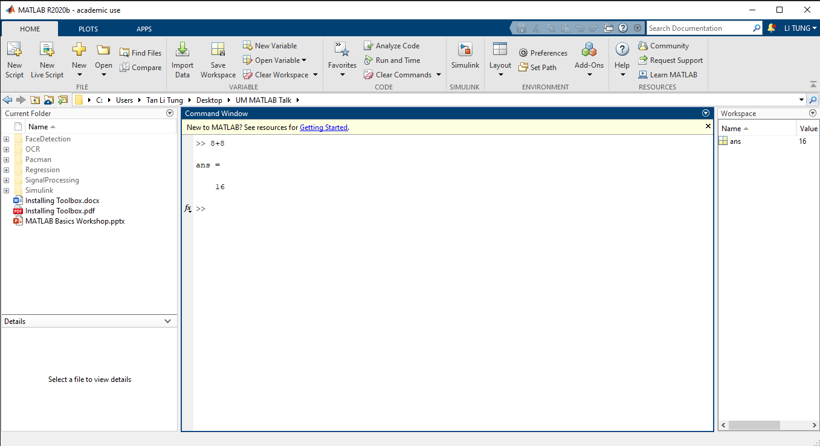
MATLAB INTERFACE
CURRENT FOLDER
CURRENT FOLDER
WORKSPACE
**Change the layout by dragging the light blue boxes.

Slide 20
BASIC OPERATIONS

Slide 21
BASIC OPERATIONS
Assigning Variables (variableName = assignedValue)
> a = 3;
Clear the command window
> clc
Clear all variables
> clear all
Clear all variables (clear variableName)
> clear a
See the details of the variables
> whos
Variables are CASE SENSITIVE
All variables are matrix

Slide 22
VARIABLES

Slide 23

DATA TYPES
Scalar
> variableName = assignedValue;
> a = 3;
Matrix
> matrixName =[a₁₁ a₁₂ … a_{1n};a₂₁ a₂₂ … a_{2n}];
> matrixA = [1 2 3; 4 5 6; 7 8 9];
* Variables are CASE SENSITIVE
$$\left[\begin{matrix}1 & 2 & 3 \\ 4 & 5 & 6 \\ 7 & 8 & 9\end{matrix}\right]$$

Slide 24
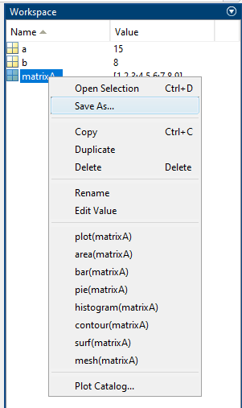
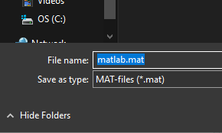
SAVE THE VARIABLES
Select the variable(s) that you want to save, right click “Save As…”
Name the file and make sure it have extension of .mat

Slide 25

LOAD THE VARIABLES
Navigate to the folder of the .mat file and select the file
The variable(s) will be loaded into workspace

Slide 26
SCALAR

Slide 27
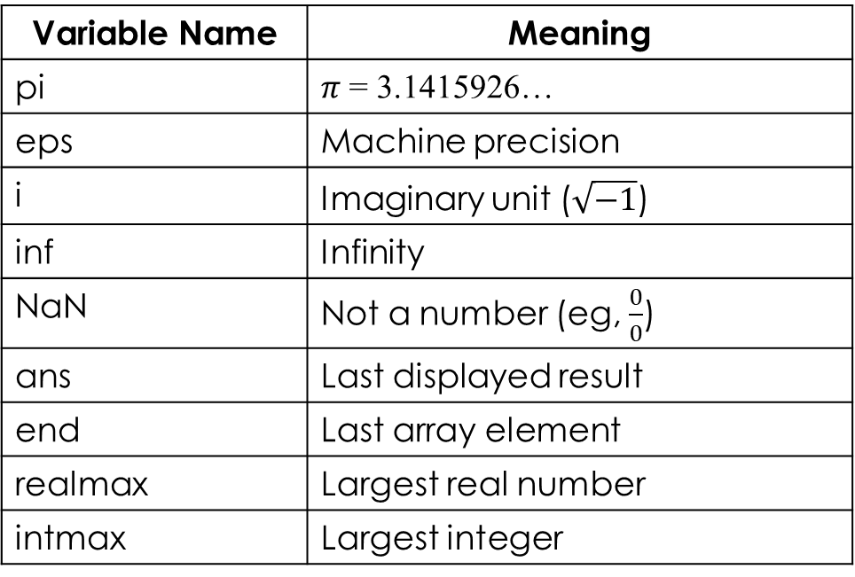
SCALAR OPERATION
Special Variable
+ - * / ^
pow, sqrt
log, exp
sin, cos, tan
asin, acos, atan
round, ceil, floor
Variable Name | Meaning
pi | $π$ = 3.1415926…
eps | Machine precision
i | Imaginary unit ($\sqrt{−1}$)
inf | Infinity
NaN | Not a number (eg, $\frac{0}{0}$)
ans | Last displayed result
end | Last array element
realmax | Largest real number
intmax | Largest integer

Slide 28
MATRIX

Slide 29
MATRIX OPERATION
+ - * / ^ ’
mpow, sqrtm
logm, expm
sum, prod
cumsum, cumprod
max, min, std, mean
length, size, eig
Command | Meaning
ones(m, n) | Create m x n matrix of 1’s
zeros(m, n) | Create m x n matrix of 0’s
eye(n) | Create n x n identity matrix
diag(vec) | Create diagonal matrix
diag(A) | Diagonal elements of A
rand(m, n) | Uniform random number matrix
randn(m, n) | Gaussian random number matrix
magix(m) | Magic square matrix
hilb | Hilbert matrix

Slide 30
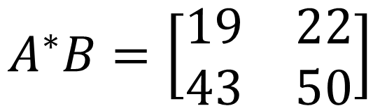
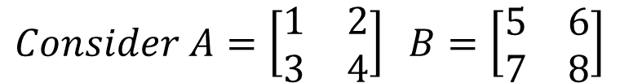
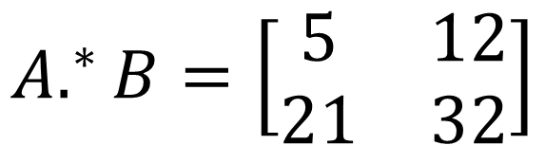
ELEMENT WISE OPERATION
+ - .* ./ .^
$$Consider A=\left[\begin{matrix}1 & 2 \\ 3 & 4\end{matrix}\right] B=\left[\begin{matrix}5 & 6 \\ 7 & 8\end{matrix}\right]$$
$$A^{∗}B=\left[\begin{matrix}19 & 22 \\ 43 & 50\end{matrix}\right]$$
$$A.^{∗}B=\left[\begin{matrix}5 & 12 \\ 21 & 32\end{matrix}\right]$$
Matrix multiplication
Element Wise multiplication

Slide 31

SUBSET A MATRIX
$$\left[\begin{matrix}1 & 2 & 3 \\ 4 & 5 & 6 \\ 7 & 8 & 9\end{matrix}\right]$$
Subset an element
Recall matrixA = [1 2 3; 4 5 6; 7 8 9];
> variableName(row, column);
> matrixA(1, 2); % Ans = 2
Subset a matrix
> variableName(row1:row2, column1:column2);
> matrixA(1:2, 2:3); % Ans = [2 3; 5 6]

Slide 32
GRAPH PLOTTING

Slide 33
GRAPH PLOTTING
Using the PLOT function
> plot(x, y, ‘lineStyle lineColor markerStyle’);
> plot(x, y, ‘--ks’);
Example
> x = 0:0.5:10;
> y = x .^ 2;
> z = x .^ 3;
> plot(x, y, ‘:ks’);
> hold on
> plot(x, z, ‘-.r^’);
> grid on

Slide 34
LINE STYLE
Line Style | Description
- | Solid line
-- | Dashed line
: | Dotted line
-. | Dash-dot line
Marker | Description
'o' | Circle
'+' | Plus sign
'*' | Asterisk
'.' | Point
'x' | Cross
'_' | Horizontal line
'|' | Vertical line
's' | Square
'd' | Diamond
'^' | Upward-pointing triangle
'v' | Downward-pointing triangle
'>' | Right-pointing triangle
'<' | Left-pointing triangle
'p' | Pentagram
'h' | Hexagram
Color | Description
y | yellow
m | magenta
c | cyan
r | red
g | green
b | blue
w | white
k | black

Slide 35
GRAPH PLOTTING
3D Plot
> z = peaks(25);
> mesh(z)
> surf(z)
> surfl(z)
> colormap(jet) % change color map

Slide 36
GRAPH PLOTTING
Another Example
figure
k = 5;
n = 2^k-1;
theta = pi*(-n:2:n)/n;
phi = (pi/2)*(-n:2:n)'/n;
X = cos(phi)*cos(theta);
Y = cos(phi)*sin(theta);
Z = sin(phi)*ones(size(theta));
colormap([0 0 0;1 1 1])
C = hadamard(2^k);
surf(X,Y,Z,C)
axis square

Slide 37
RESOURCES

Slide 38
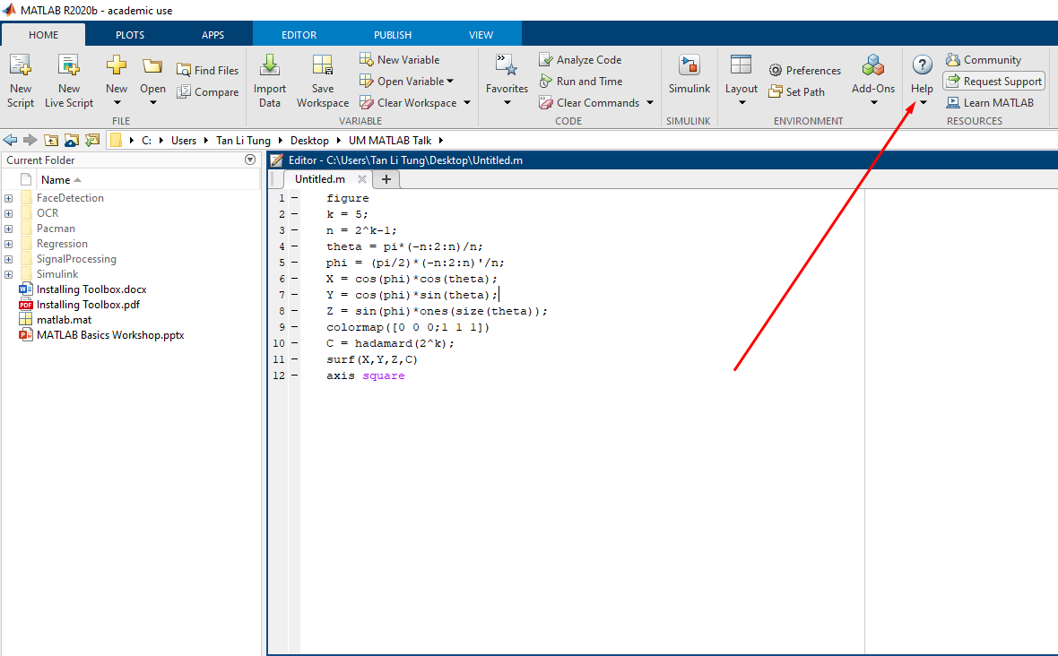
MATLAB DOCUMENTATION

Slide 39
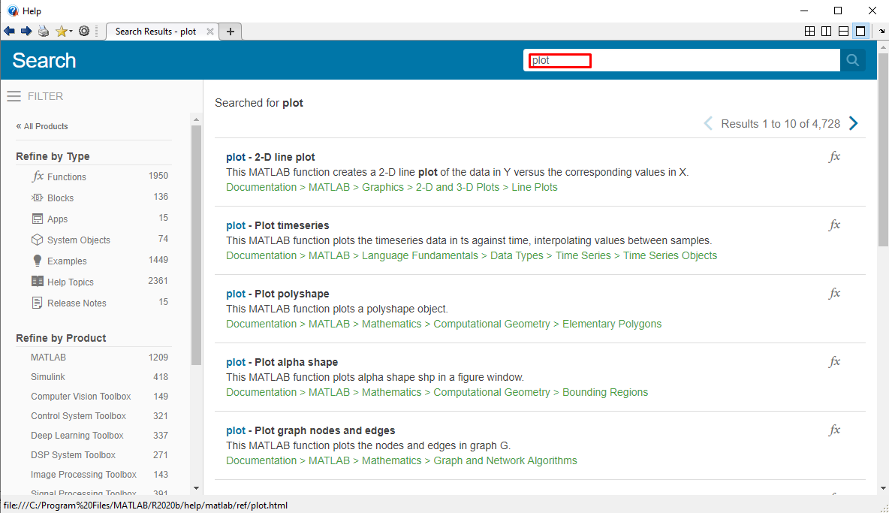
MATLAB DOCUMENTATION

Slide 40
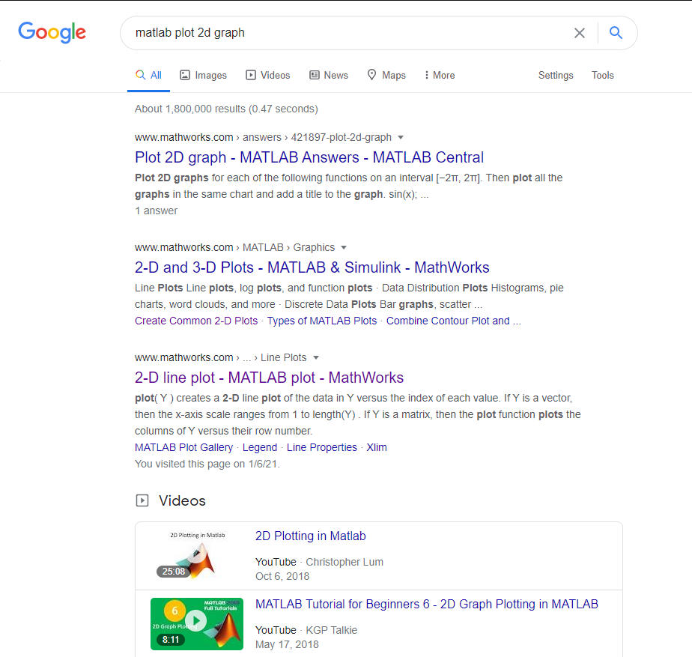
MATLAB DOCUMENTATION

Slide 41
INDUSTRY USE

Slide 42
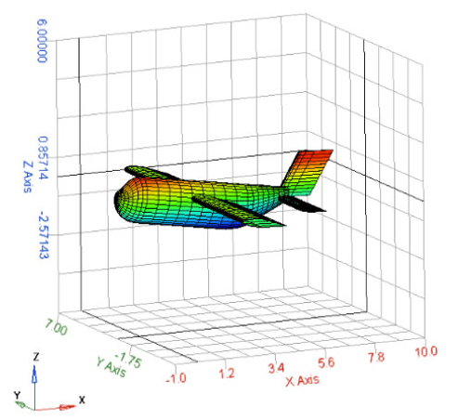
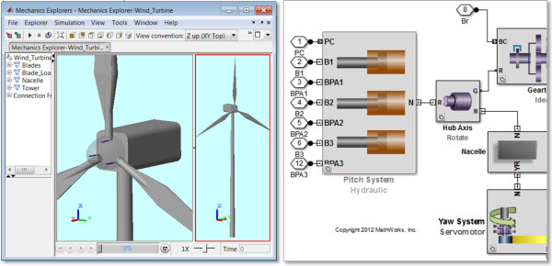
MATLAB USAGE IN THE INDUSTRIES
Aircraft System Modelling
Wind Turbine Modelling

Slide 43
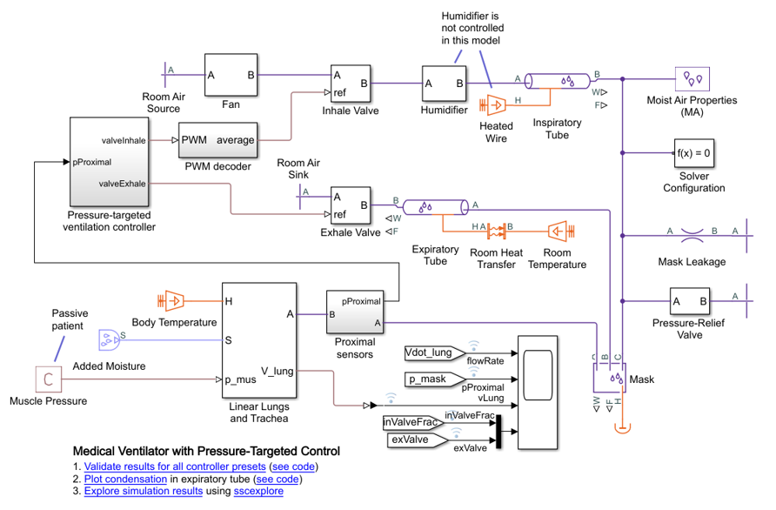
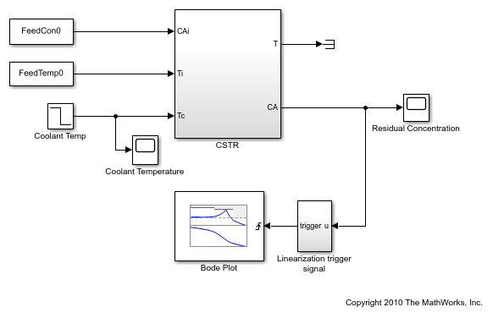
MATLAB USAGE IN THE INDUSTRIES
Medical Ventilation Modelling
Chemical Reactor Modelling

Slide 44
USEFUL LINKS
MATLAB Academy (Certification)
https://matlabacademy.mathworks.com
MATLAB for Beginners
https://www.youtube.com/watch?v=T_ekAD7U-wU
Solving ODEs in MATLAB
https://www.mathworks.com/help/symbolic/solve-a-single-differential-equation.html

Slide 45
THANK YOU

